Slide 1
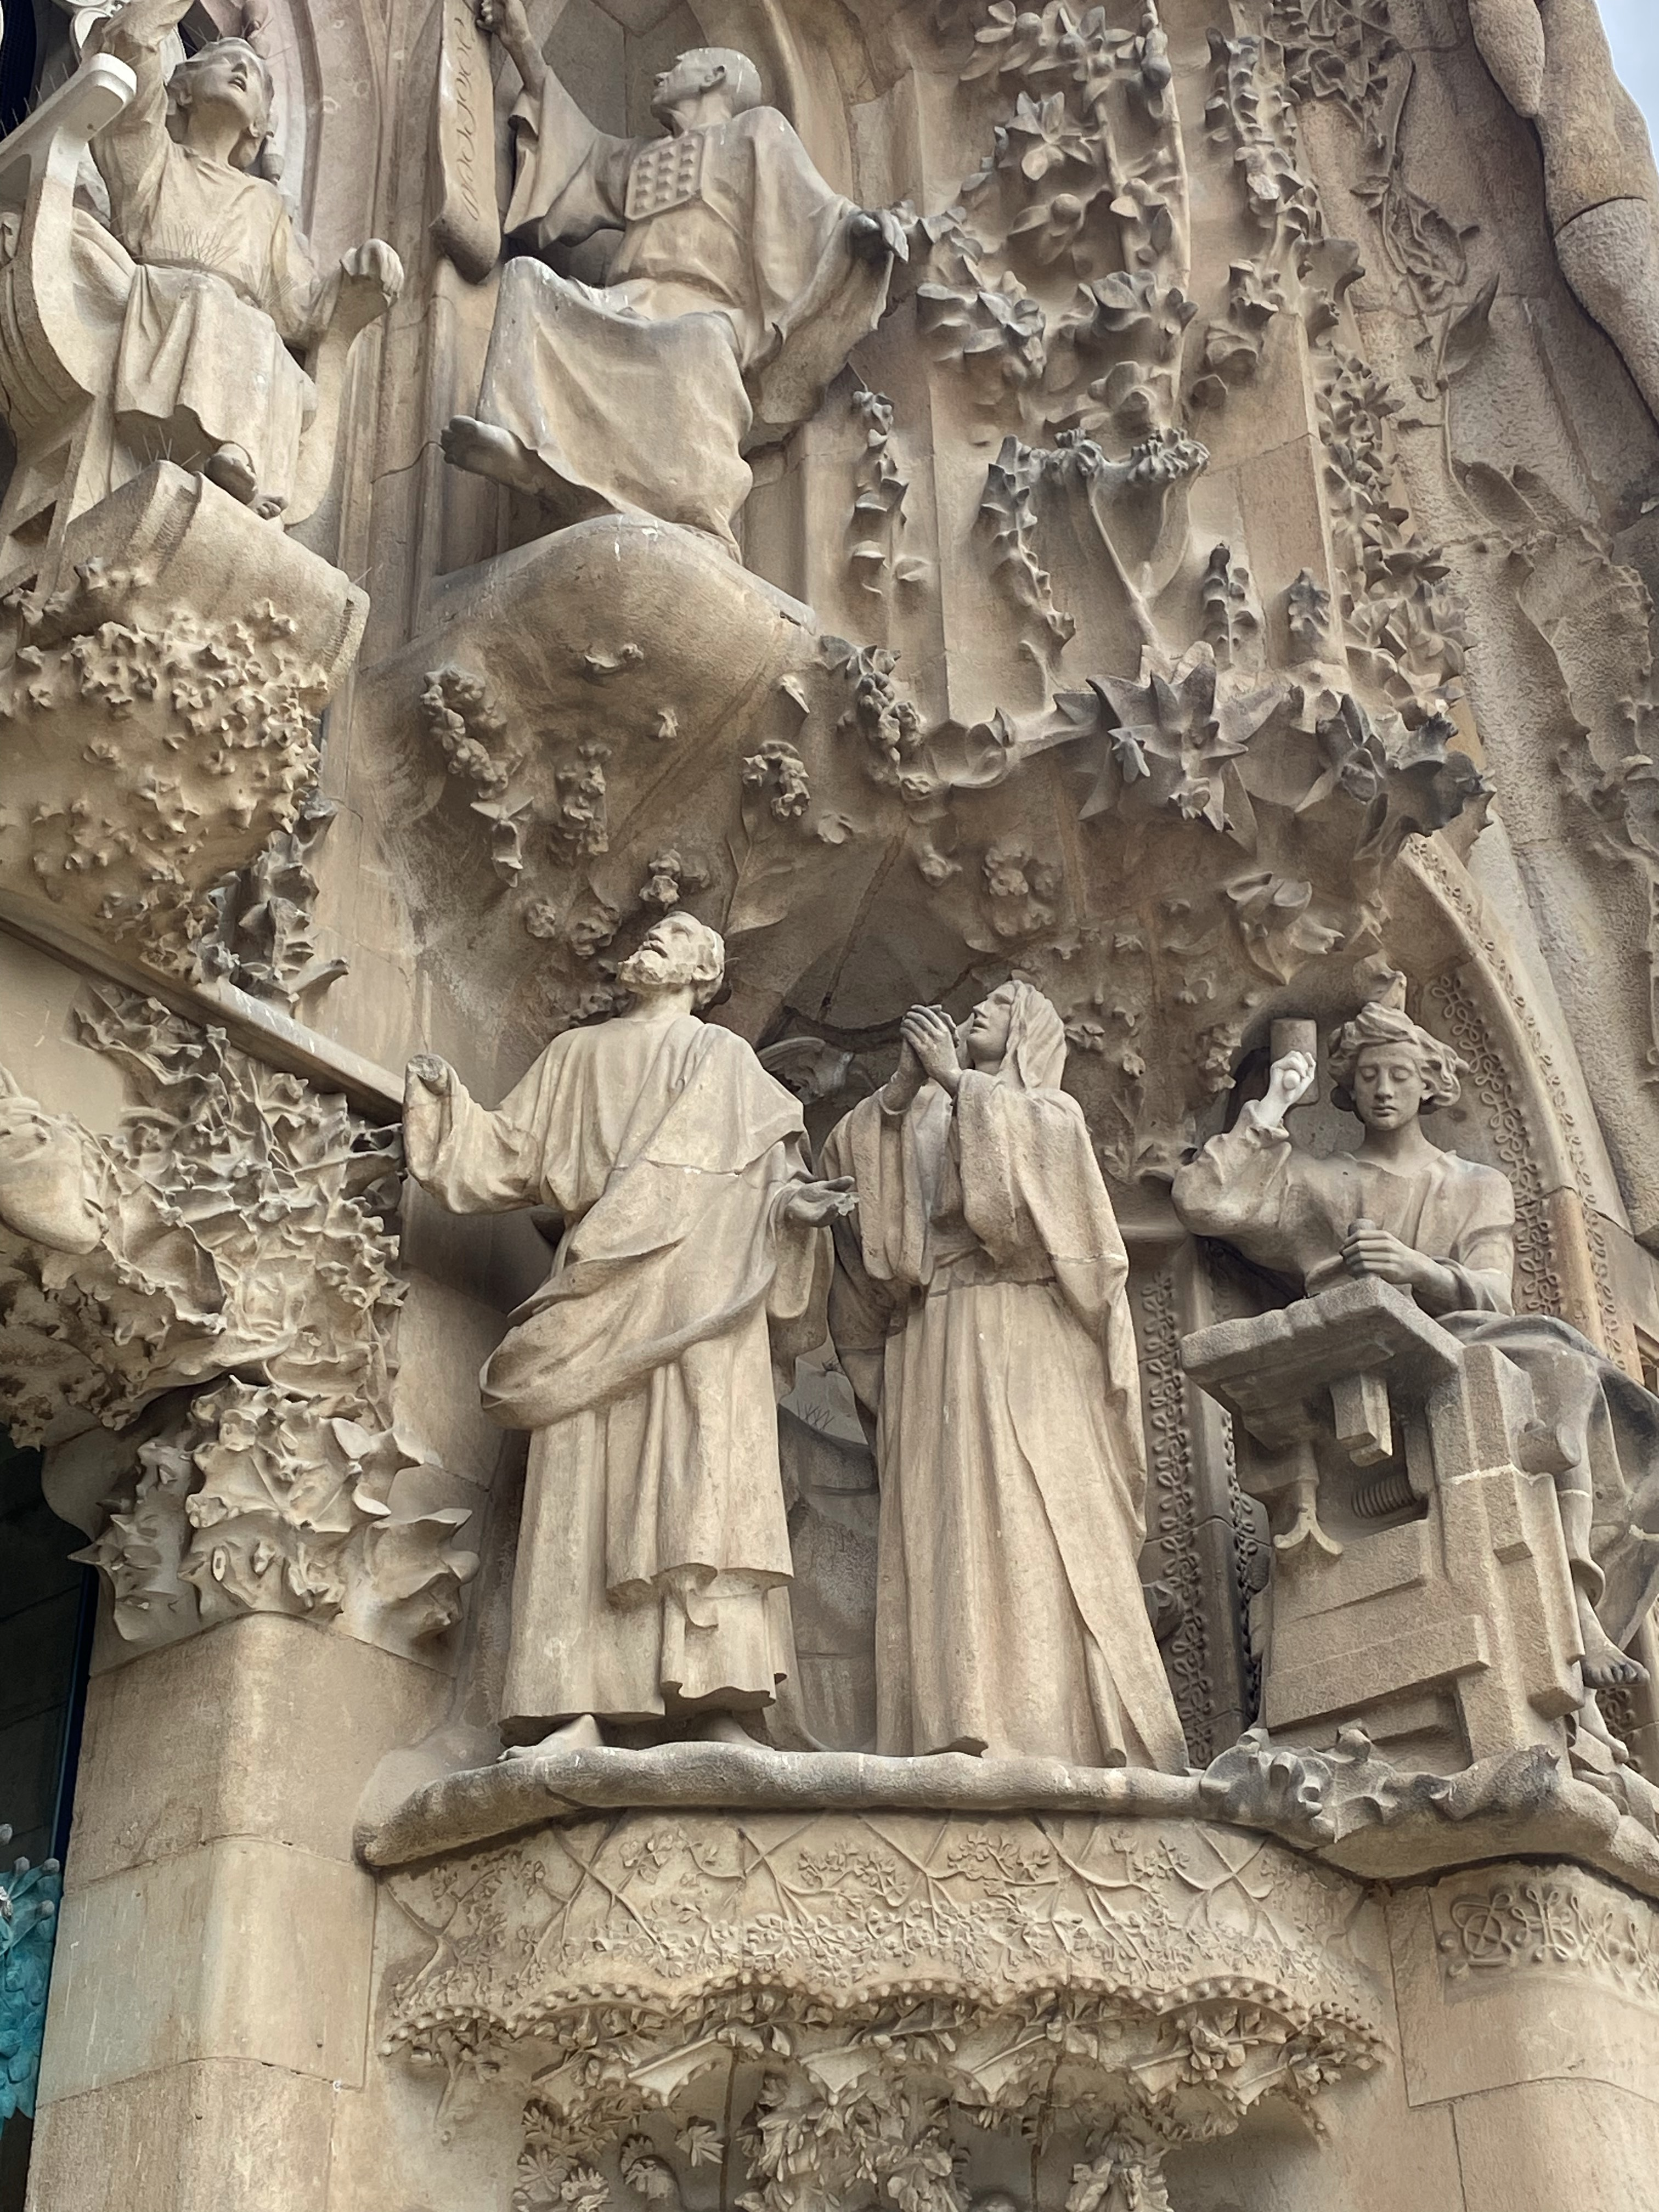
Use of reference

Slide 2

ALTERNATIVES
Notes:
What are we documenting? A set of decision…
What drives us to make a decision?
And how do we make a decision?
Strategy? A plan? A goal?
Chess Games Kasrparov or Fischer
Photo by <a href="https://unsplash.com/@jeshoots?utm_source=unsplash&utm_medium=referral&utm_content=creditCopyText">JESHOOTS.COM</a> on <a href="https://unsplash.com/photos/fzOITuS1DIQ?utm_source=unsplash&utm_medium=referral&utm_content=creditCopyText">Unsplash</a>

Slide 3

WE MAKE DECISIONS
ALL THE TIME
unsplash.com/@rhowerter
Notes:
We all make decisions…

Slide 4
ANTI PATTERNS
Notes:
Fundamentals of Software Architecture: An Engineering Approach
Book by Mark Richards and Neal Ford

